Slide 1
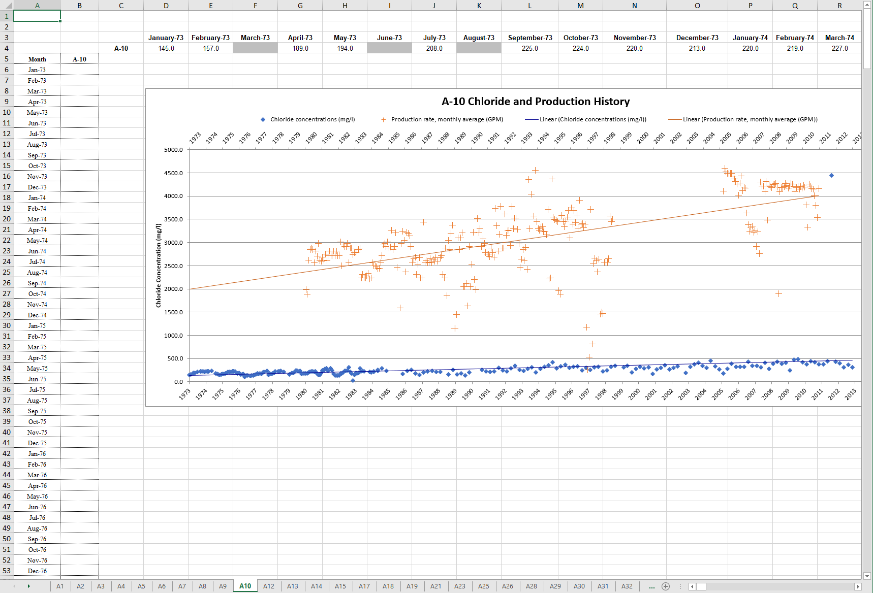
Notes:
I inherited the Chloride-production database in early-fall of last year and have updated it to include all the data WERI has up to December 2019.
Here is an example of the database files available from Guam Hydrological Survey website
The database has separate Excel files for each well
Here, I’ve combined them into one file with separate tabs for each well
Each well has a chart for chloride and production history, which I am working to update with data from recent years.

Slide 2
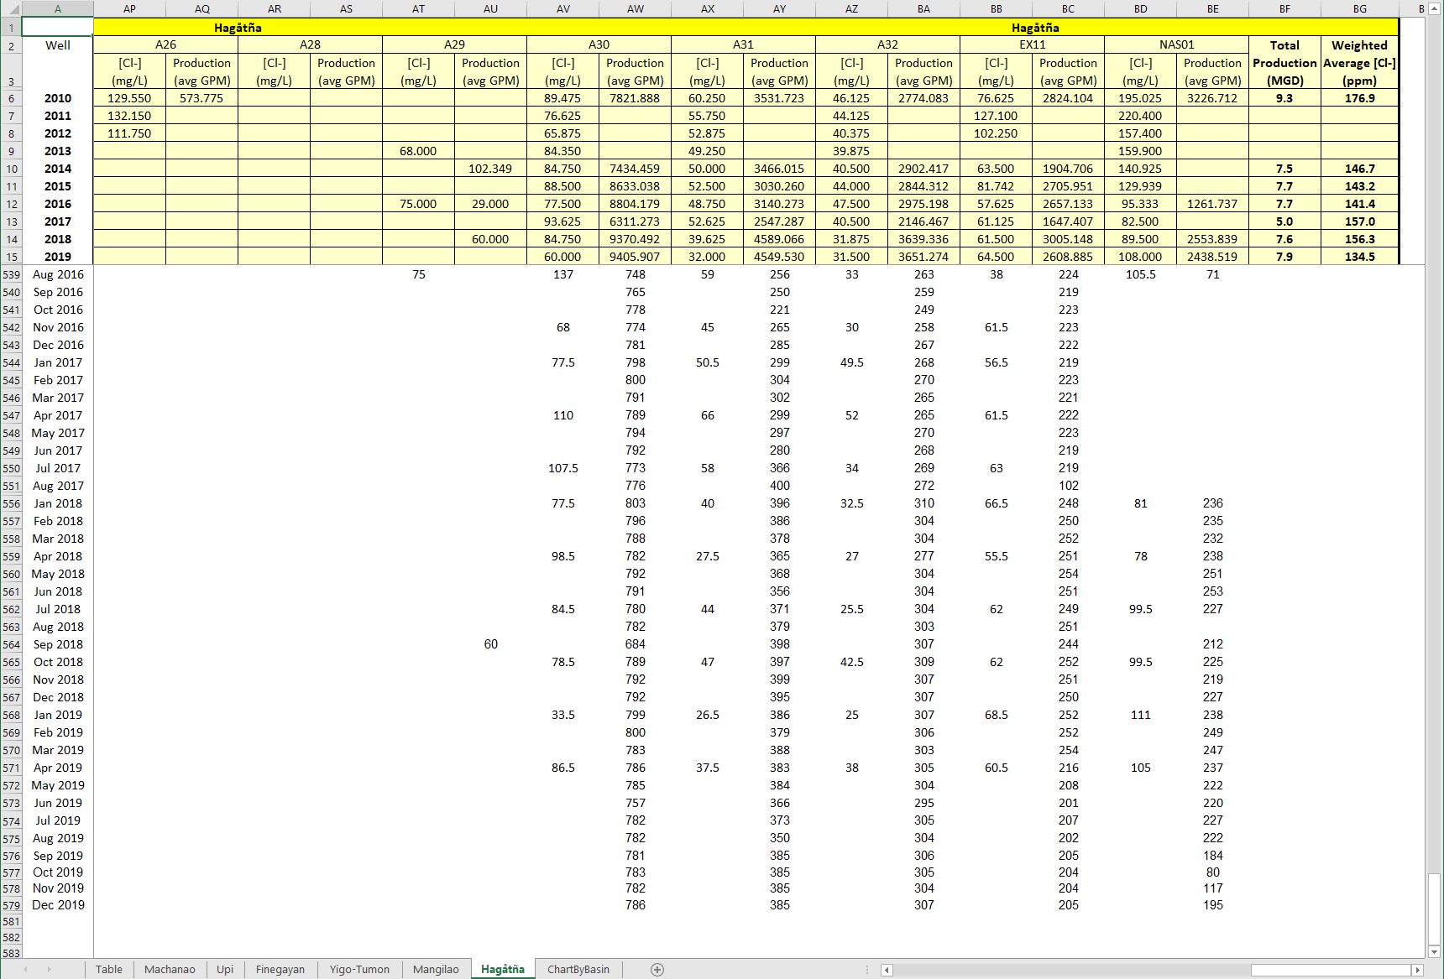
Notes:
This is the current format that I am using for the Chloride-Production Database with a single Excel file.
Here I have Wells organized into respective basins, indicated by the tabs
Helps to isolate data, which is particularly useful for my project. More info on that later
For each well for each year (2010–2019), we have the production values in average gallons per minute, and weighted averages for chloride concentration in mg/L
You may notice wells without data in recent years, which were offline during those times and thus not producing.

Slide 3
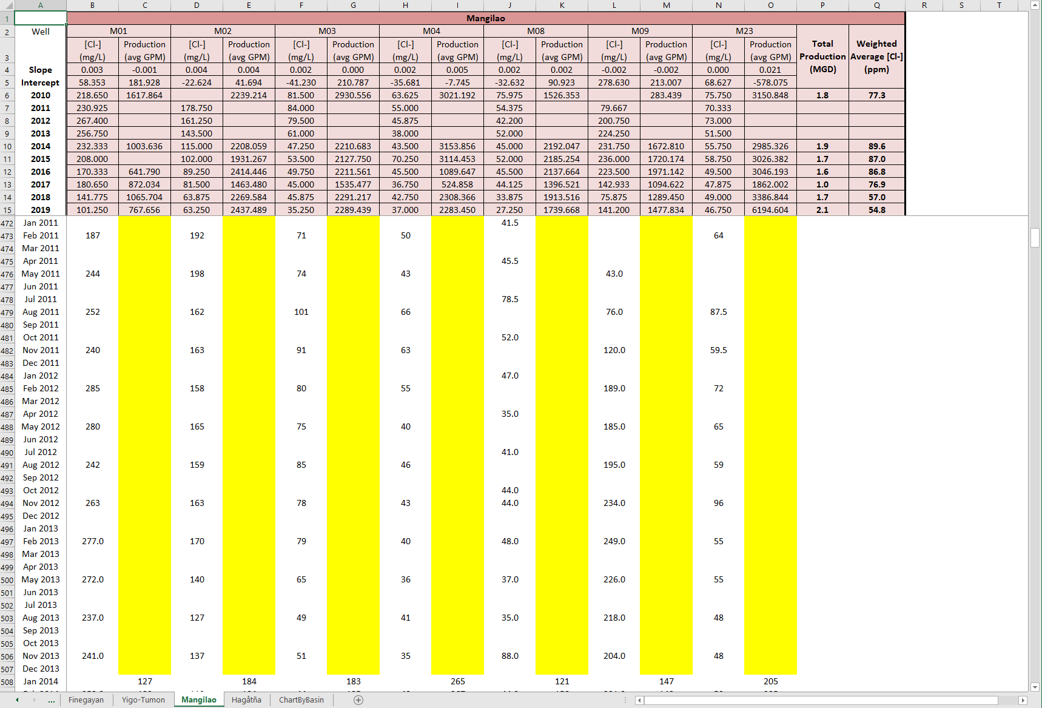
Notes:
We do have Gaps in data: 2011-2013, a few months in 2017. We are thankful to Mr. Joe Garrido from GWA who has been supplying us data at least since 2013.
- With more data, we can more accurately analyze trends in chloride and production.
Simard’s database up to 2010 included data from DoD and private wells
- Since then, we have only had data from GWA

Slide 4
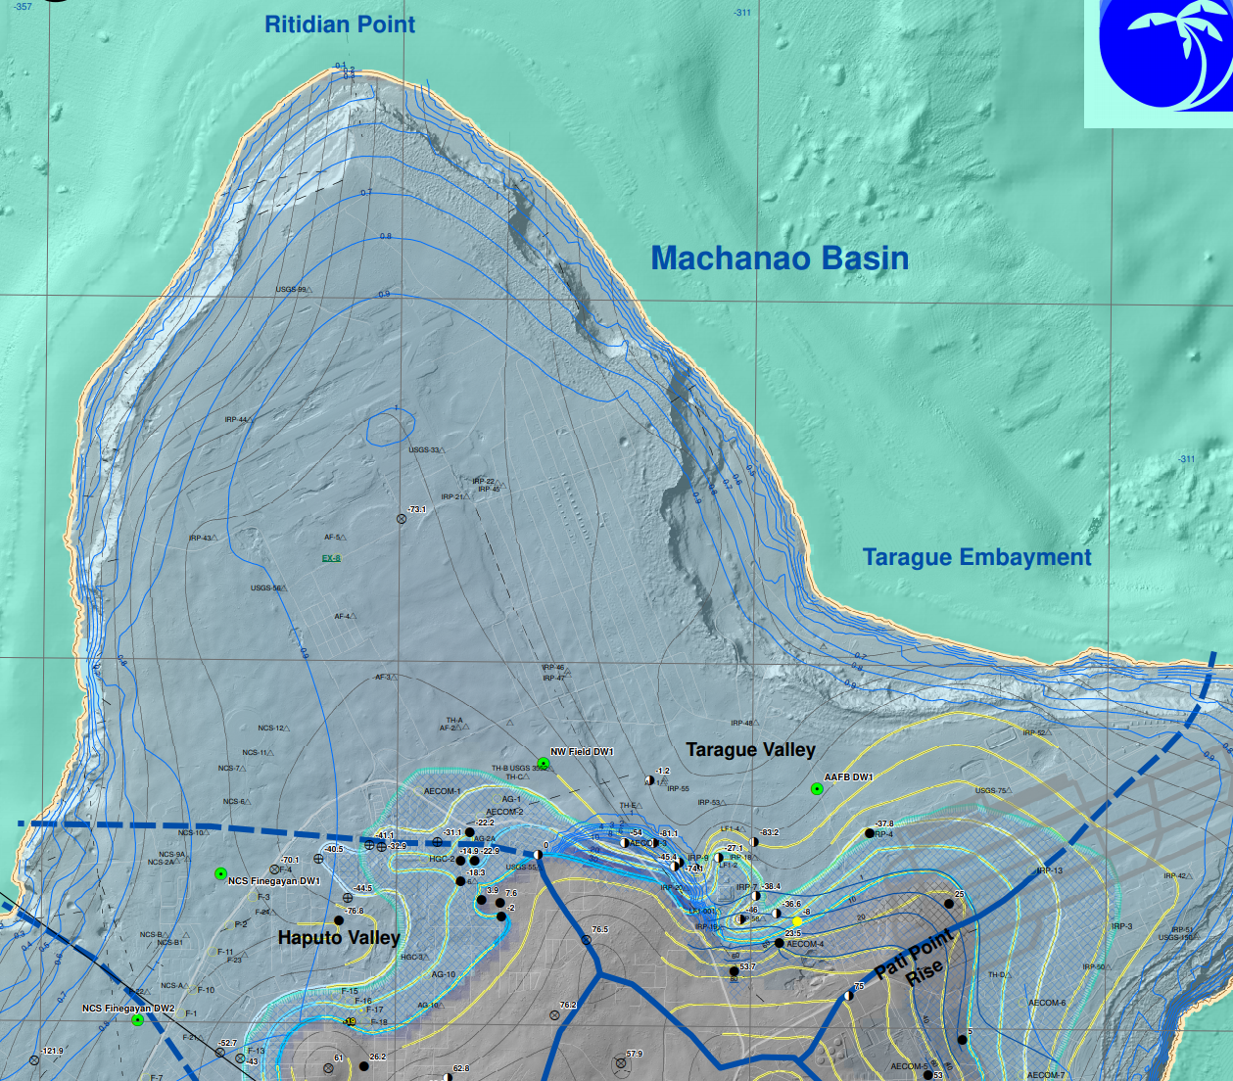
2 wells
Notes:
With the updated chloride-production database, I have generated some preliminary charts, which I hope to refine.
This graph shows trends in production and chloride for the Machanao basin for the years 2014 to 2019. Production, in millions of gallons per day, is in shown in blue triangles, and chloride weighted averages, in parts per million, are shown in orange circles.
For the 2 wells in the Machanao basin, we see an increase in production and a decrease in average chloride.

Slide 5
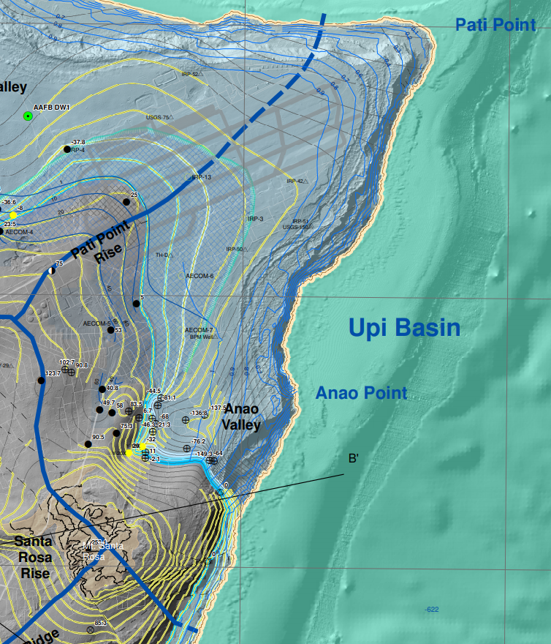
2 wells
Notes:
Upi Basin
2 wells
Increase in production
Decrease in chloride

Slide 6
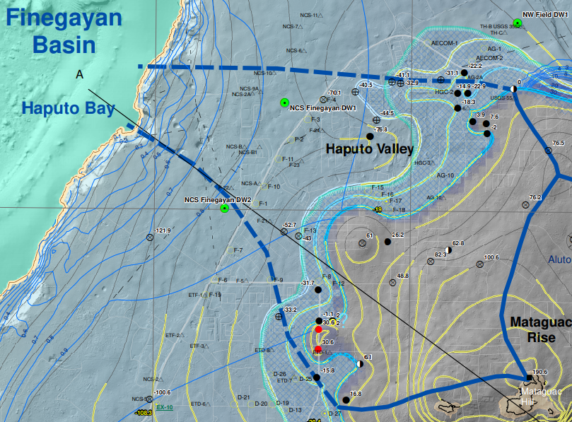
16 wells
Notes:
Finegayan Basin
16 wells
Slight increase in production
Decrease in chloride

Slide 7
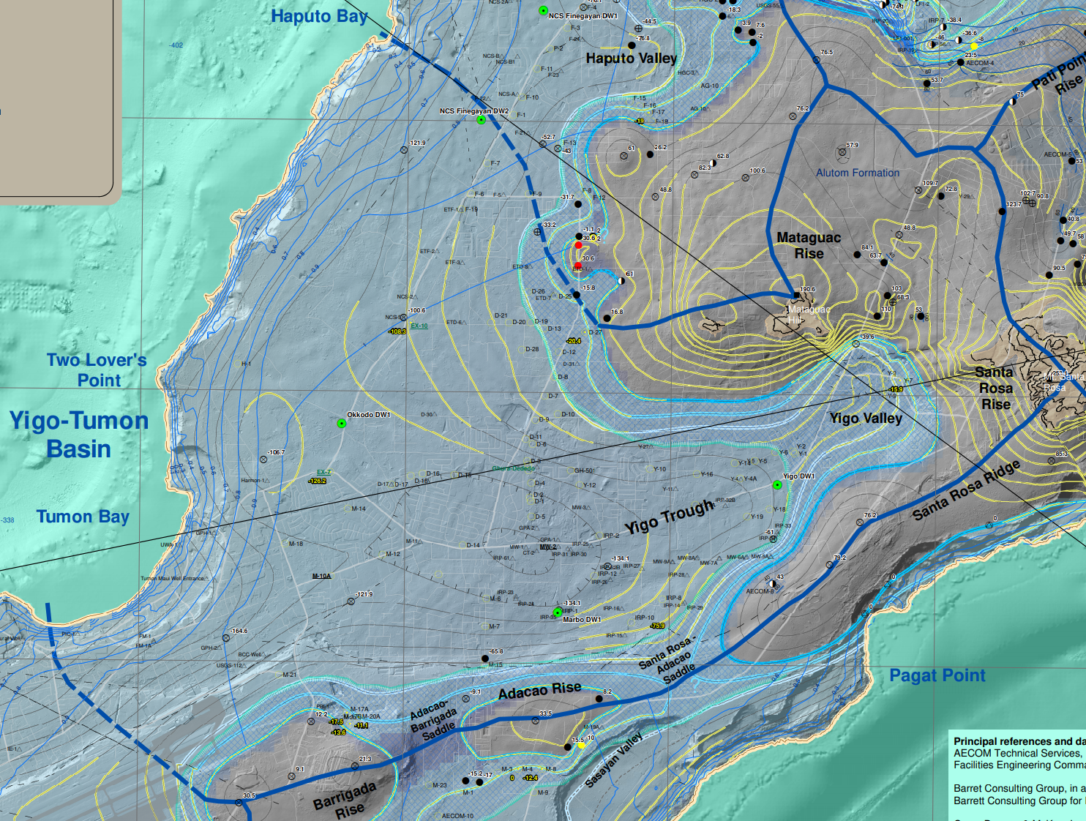
64 wells
Notes:
Yigo-Tumon Basin
64 wells
Production generally the same
Decrease in chloride

Slide 8
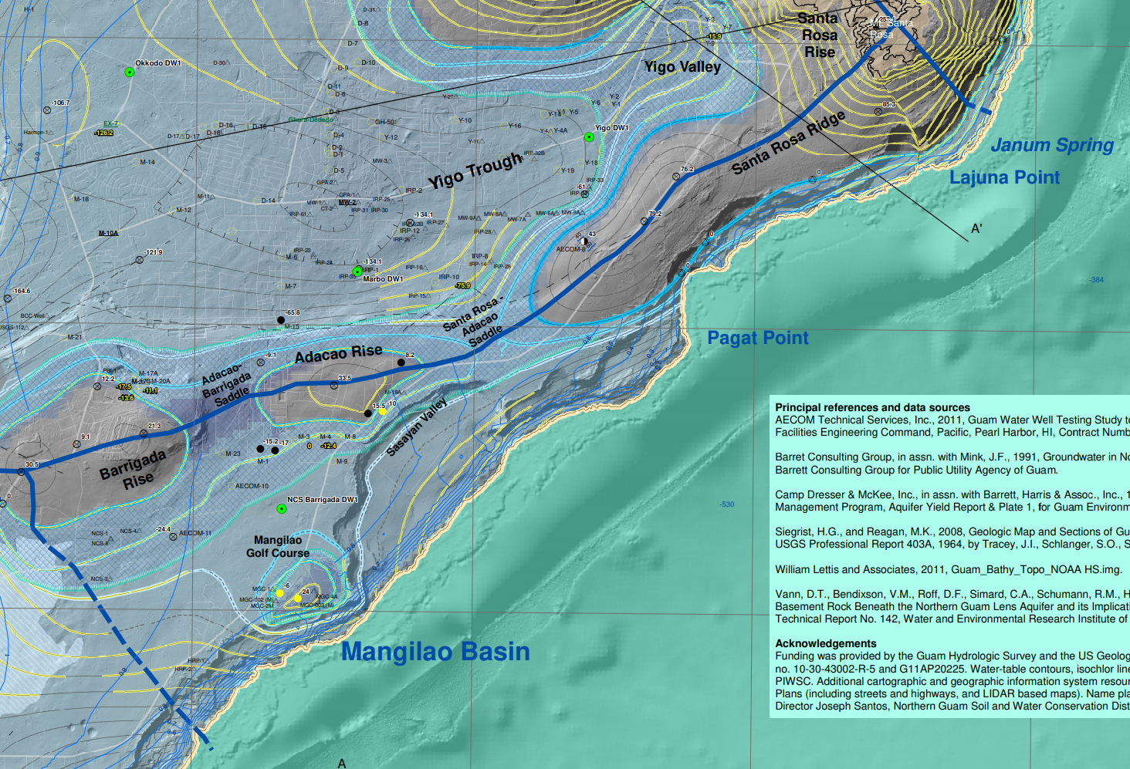
7 wells
Notes:
Mangilao Basin
7 wells
Slightly increased production
Decrease in chloride

Slide 9
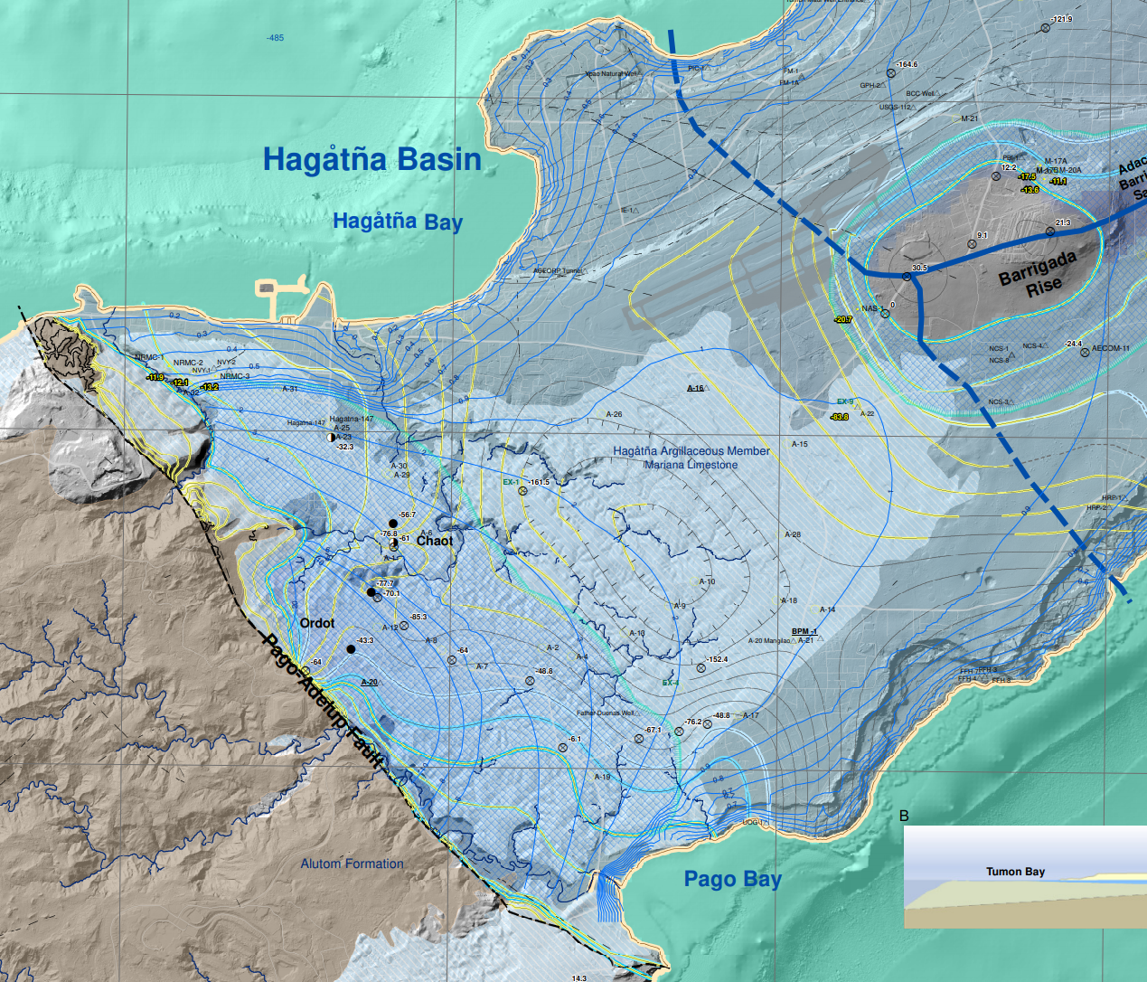
28 wells
Notes:
Hagåtña Basin
28 wells
Generally the same production and chloride

Slide 10
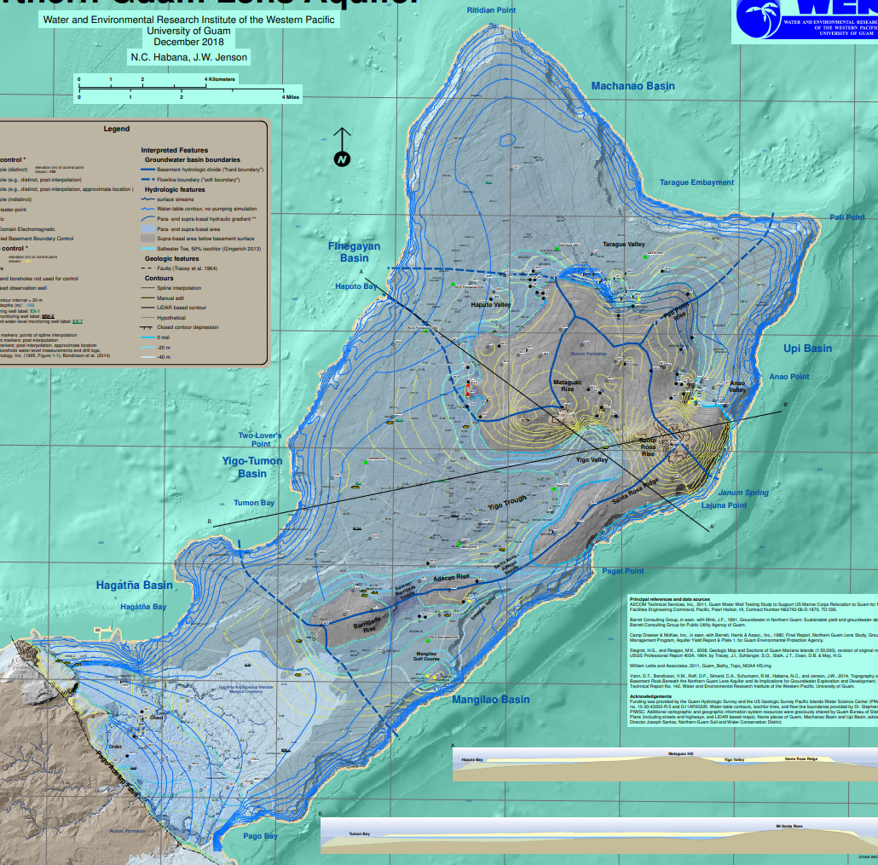
Notes:
Here we have a graph showing each of the 6 basins and their trends in chloride weighted averages from 2014 to 2019.
With the caveat that there are factors other than production that affect chloride values, it seems that although GWA’s production has generally gone up in the last several years, the average chloride has generally gone down.

Slide 11
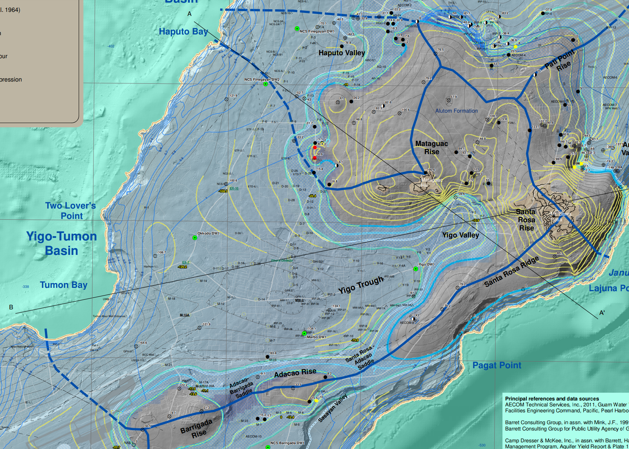
UTM, WGS 84, Zone 55N
Pugua Fault
Flow Lines
No pumping hydraulic gradient
Gingerich (2013)
Ghyben Herzberg – spatial analysis
Basement Topography
Vann et al. (2013)
Flow Lines
No pumping hydraulic gradient
Gingerich (2013)
Ghyben Herzberg – spatial analysis
FEMWATER lesson
Faults / Geologic Features
Stratigraphy
Siegrist et al. (2007)
Faults / Geologic Features
Stratigraphy
Siegrist et al. (2007)
Scissors Fault
Delineation of Basement Ridge
Gingerich (2013)
Vann et al. (2013)
Notes:
My project will develop a groundwater model of the Yigo-Tumon Basin.
Over the years, WERI has accumulated a large amount of data that we can use to build and test the model.
We will reference Gingerich’s 2013 model and include WERI’s research up to the work of Bekah Dougher and Dan Superales from just last year.

Slide 12
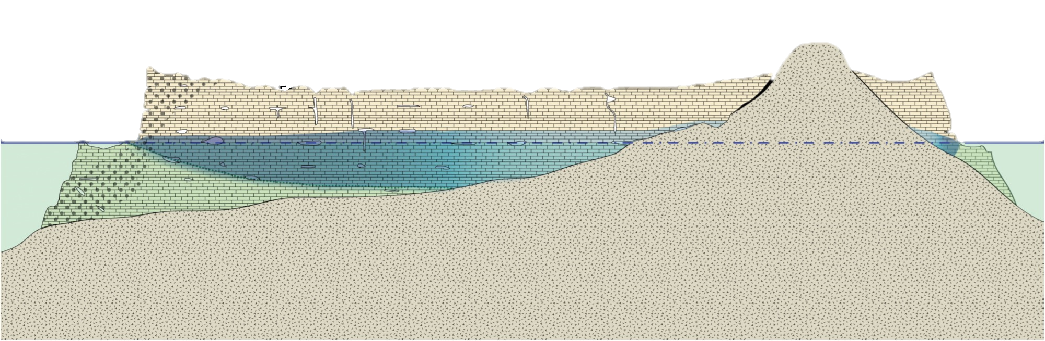
Production Weighted Average & …
Superales et al. (2019)
OWLs
(water table, well depth)
Bendixson (2013)
USGS Water Data
Coastal Discharge
Jocson (1999)
Shalilian (2017)
Walker et al.
DOWLs
Dougher et al. (2019)
USGS Water Data
Allogenic Recharge
GIS Analysis
Johnson (2012)
Recharge
Johnson (2012)
NCDC Precip. Data
NOAA
Tide Data
Salinity
Simard (2013)
Dougher et al. (2019)
New data – CPDB
Initial Conditions
Ghyben-Herzberg
Gingerich (2013)
Basement
(bottom confinement)
Vann et al. (2014)
Hydraulic Conductivity (K)
Rotzoll et al. (2013)
Delimitation: Phreatic only, no vadose
Notes:
As you may see in this slide, we have an abundance of data to go into creating the model.
Simard’s work and the updates to the Chloride-Production Database will be used to calibrate our model by matching model values to historical data from the chloride-production database

Slide 13


Goal:
Build reliable groundwater model of Y-T Basin
Purpose:
Test aquifer stress and optimal well configurations
Specific Objectives:
Study Y-T Basin and modeling platform to determine useful data, configuration
Simulation and “calibration”
Determine well configuration scenario to test optimum development of aquifer and stress
Interpret results, consult with committee, technical support, and partners for modifications
Recommend use of the model (incl. training) to partner agencies (GEPA, DoD, and GWA)
Notes:
Goal (Aim):
To build a reliable groundwater model of the Yigo-Tumon Basin in the NGLA.
Purpose (Intent, Utility, Reason):
To be able to test aquifer stress and optimal well configurations in the basin.
Specific Objectives (Things I will do to accomplish thesis and achieve goal and purpose):
Study the Yigo-Tumon Basin and modeling platform to determine useful data (basis for parameter settings) and configuration to build the groundwater model
Run simulations and match results with known hydrological survey data (“calibration”)
Determine a well configuration scenario to test optimum development of aquifer and stress (I will discuss this in the next slide)
Interpret results for objectives 2 and 3, consult with committee, technical support, and partners for necessary modifications
Recommend the use of the model, including training, to partner agencies (GEPA, DoD, and GWA)

Slide 14
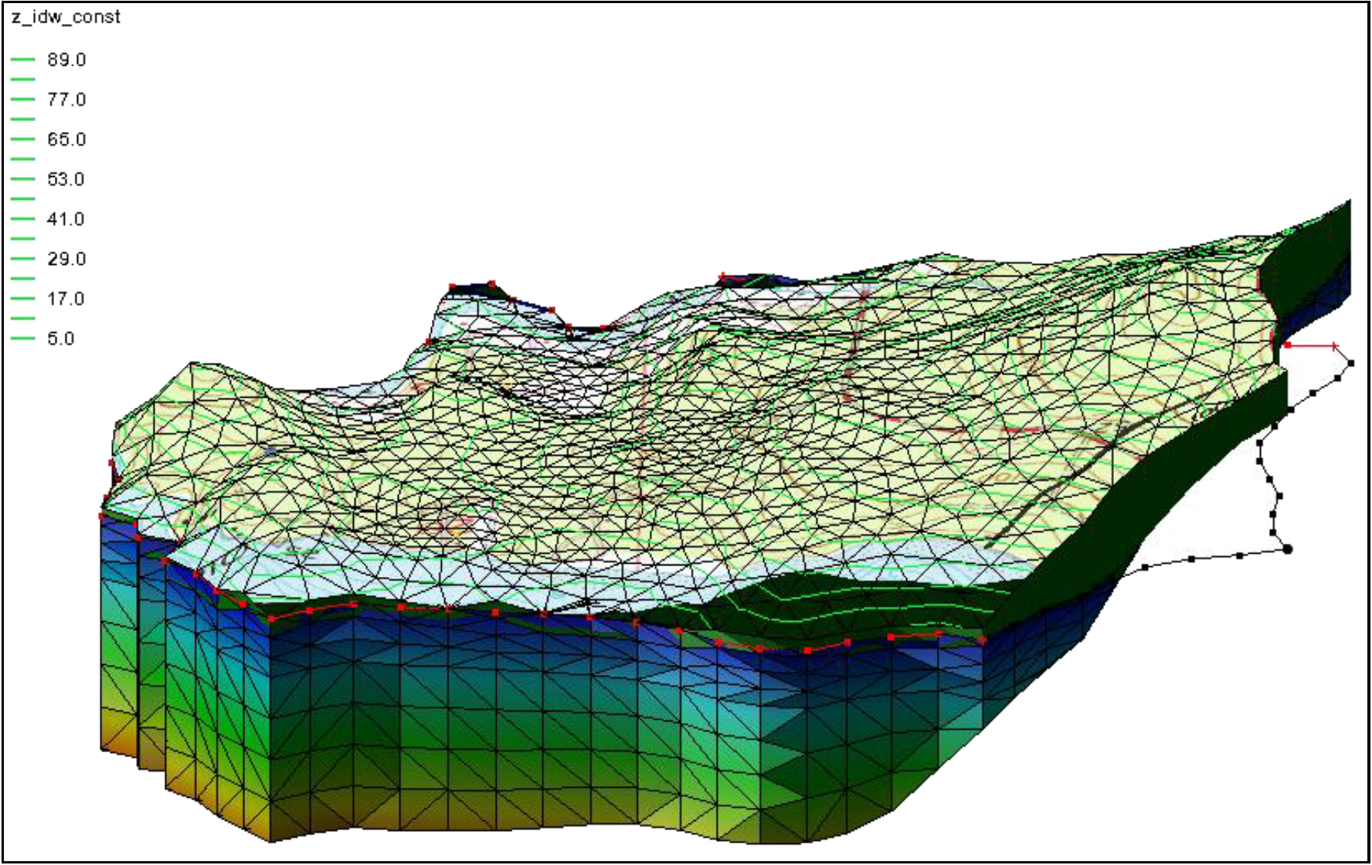
(Brett) Railey Scenario
Maximize economic development of well relocation
  Pick <200 GPM, high-chloride wells
  Move them to best zone
Save money, avoid developing in same problematic location
Notes:
We aim to include at least one scenario, which we are calling the Railey Scenario
In this, we would like to look at the problematic wells, or those producing less than 200 gallons per minute and/or with high chloride values, and analyze the results of repositioning these wells to zones with higher quantity and quality water.
This hypothetical scenario may be more economically beneficial by avoiding the development of a well adjacent to one that has been problematic and shut down.

Slide 15
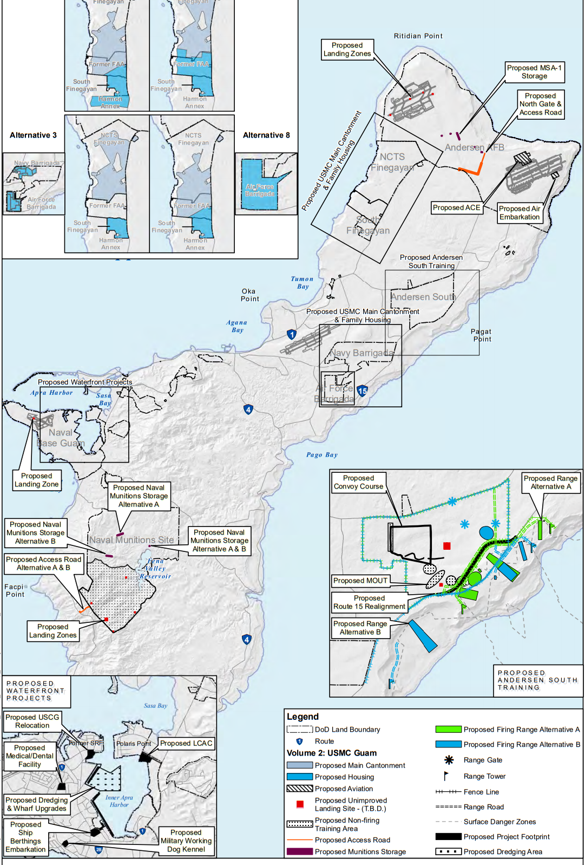
Benefits and Expected Results
Reliable model
Improve upon former models
Better understanding of NGLA
Informed technical advice for management, policy-makers
Identify need for more data collection
Evaluate use of GMS, FEMWATER for future use
Easy update and documentation
Notes:
The resulting product will be a reliable model of the Yigo-Tumon Basin. It will serve as WERI and Guam’s tool to assess any future development ideas over this aquifer basin. This project is expected to improve upon all former models of the NGLA, as the first phase with the Yigo-Tumon basin that will eventually expand into developing an updated and upgraded model of the entire NGLA. The model serves as a tool for acquiring a better understanding of the NGLA. Model results will provide informed technical advice to water resources management in making confident and reliable decisions as well as determining appropriate policies for groundwater protection. Furthermore, the model can help identify areas where more data collection is needed, capacities, well arrangement, and “sweet spots,” which may be an area where the next set of wells may be located.
This project is the first to utilize Aquaveo® Groundwater Modeling Systems (GMS), the forefront of groundwater modeling software application, for Guam and evaluates its future application to other basins of the NGLA. With the groundwater model developed by WERI, model updates and documentation will be more easily accomplished. This will keep the model in its most advanced and latest state, ready for the future and in position to incorporate the seven new observation wells being developed by the U.S. Navy—and their data—when they are up and running.
[Map from US Navy Environmental Impact Statement Executive Summary, Department of the Navy (2010)]

Slide 16

Thank you!
Questions? Comments?
Thomas M. Aguilo
aguilot@triton.uog.edu
Dr. Nathan Habana
nchabana@triton.uog.edu
Dr. John Jenson
jjenson@triton.uog.edu

